Slide 1
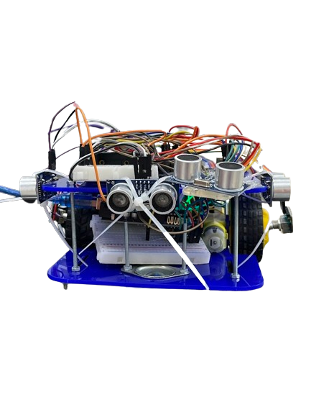

ECE-321
15-05-2024
Companion Robot for the Visually Impaired
Supervised by:
Prof. Adel Bedair Prof. Moataz Abdelwahab
Mariam Mohamed Gadallah 120210299
Eyad Mohamed Ossman 120210309
Mohamed Moataz Sallam 120210343
Youssef Mohamed Hatem 120210359

Slide 2
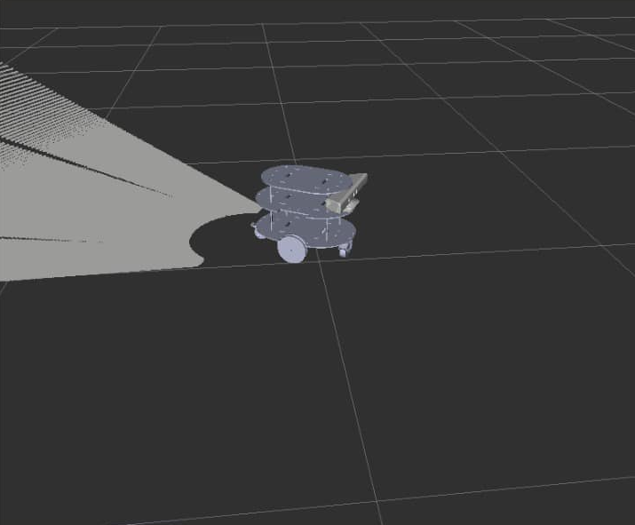
Introduction
What is the aim of the project?
The robot aim is to guide a visually impaired person through a room, the robot scans the room then guide the person through voice instructions.
It uses 4 ultrasonic sensors to scan the room and the rotary encoders to get the map readings.
Figure 1: Robot scanning a room
ECE-321
ECE-319
ECE-319

Slide 3
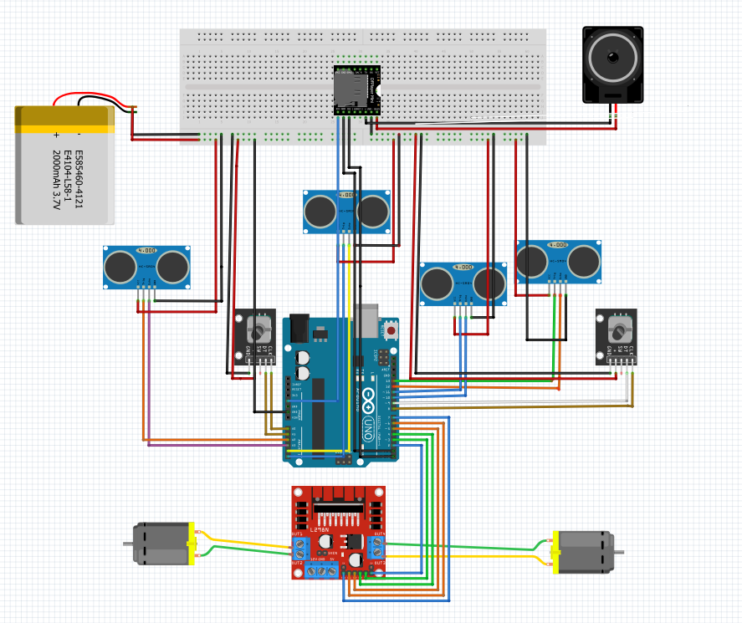
Project Components
Arduino Uno
Ultrasonic Sensors [HC-SR04] x4
L298N motor Driver
Rotary Angle Encoder x2
DC Motors x2
MP3 Player
Speaker
Battery
ECE-321
Figure 2: Connection schematic
ECE-319

Slide 4
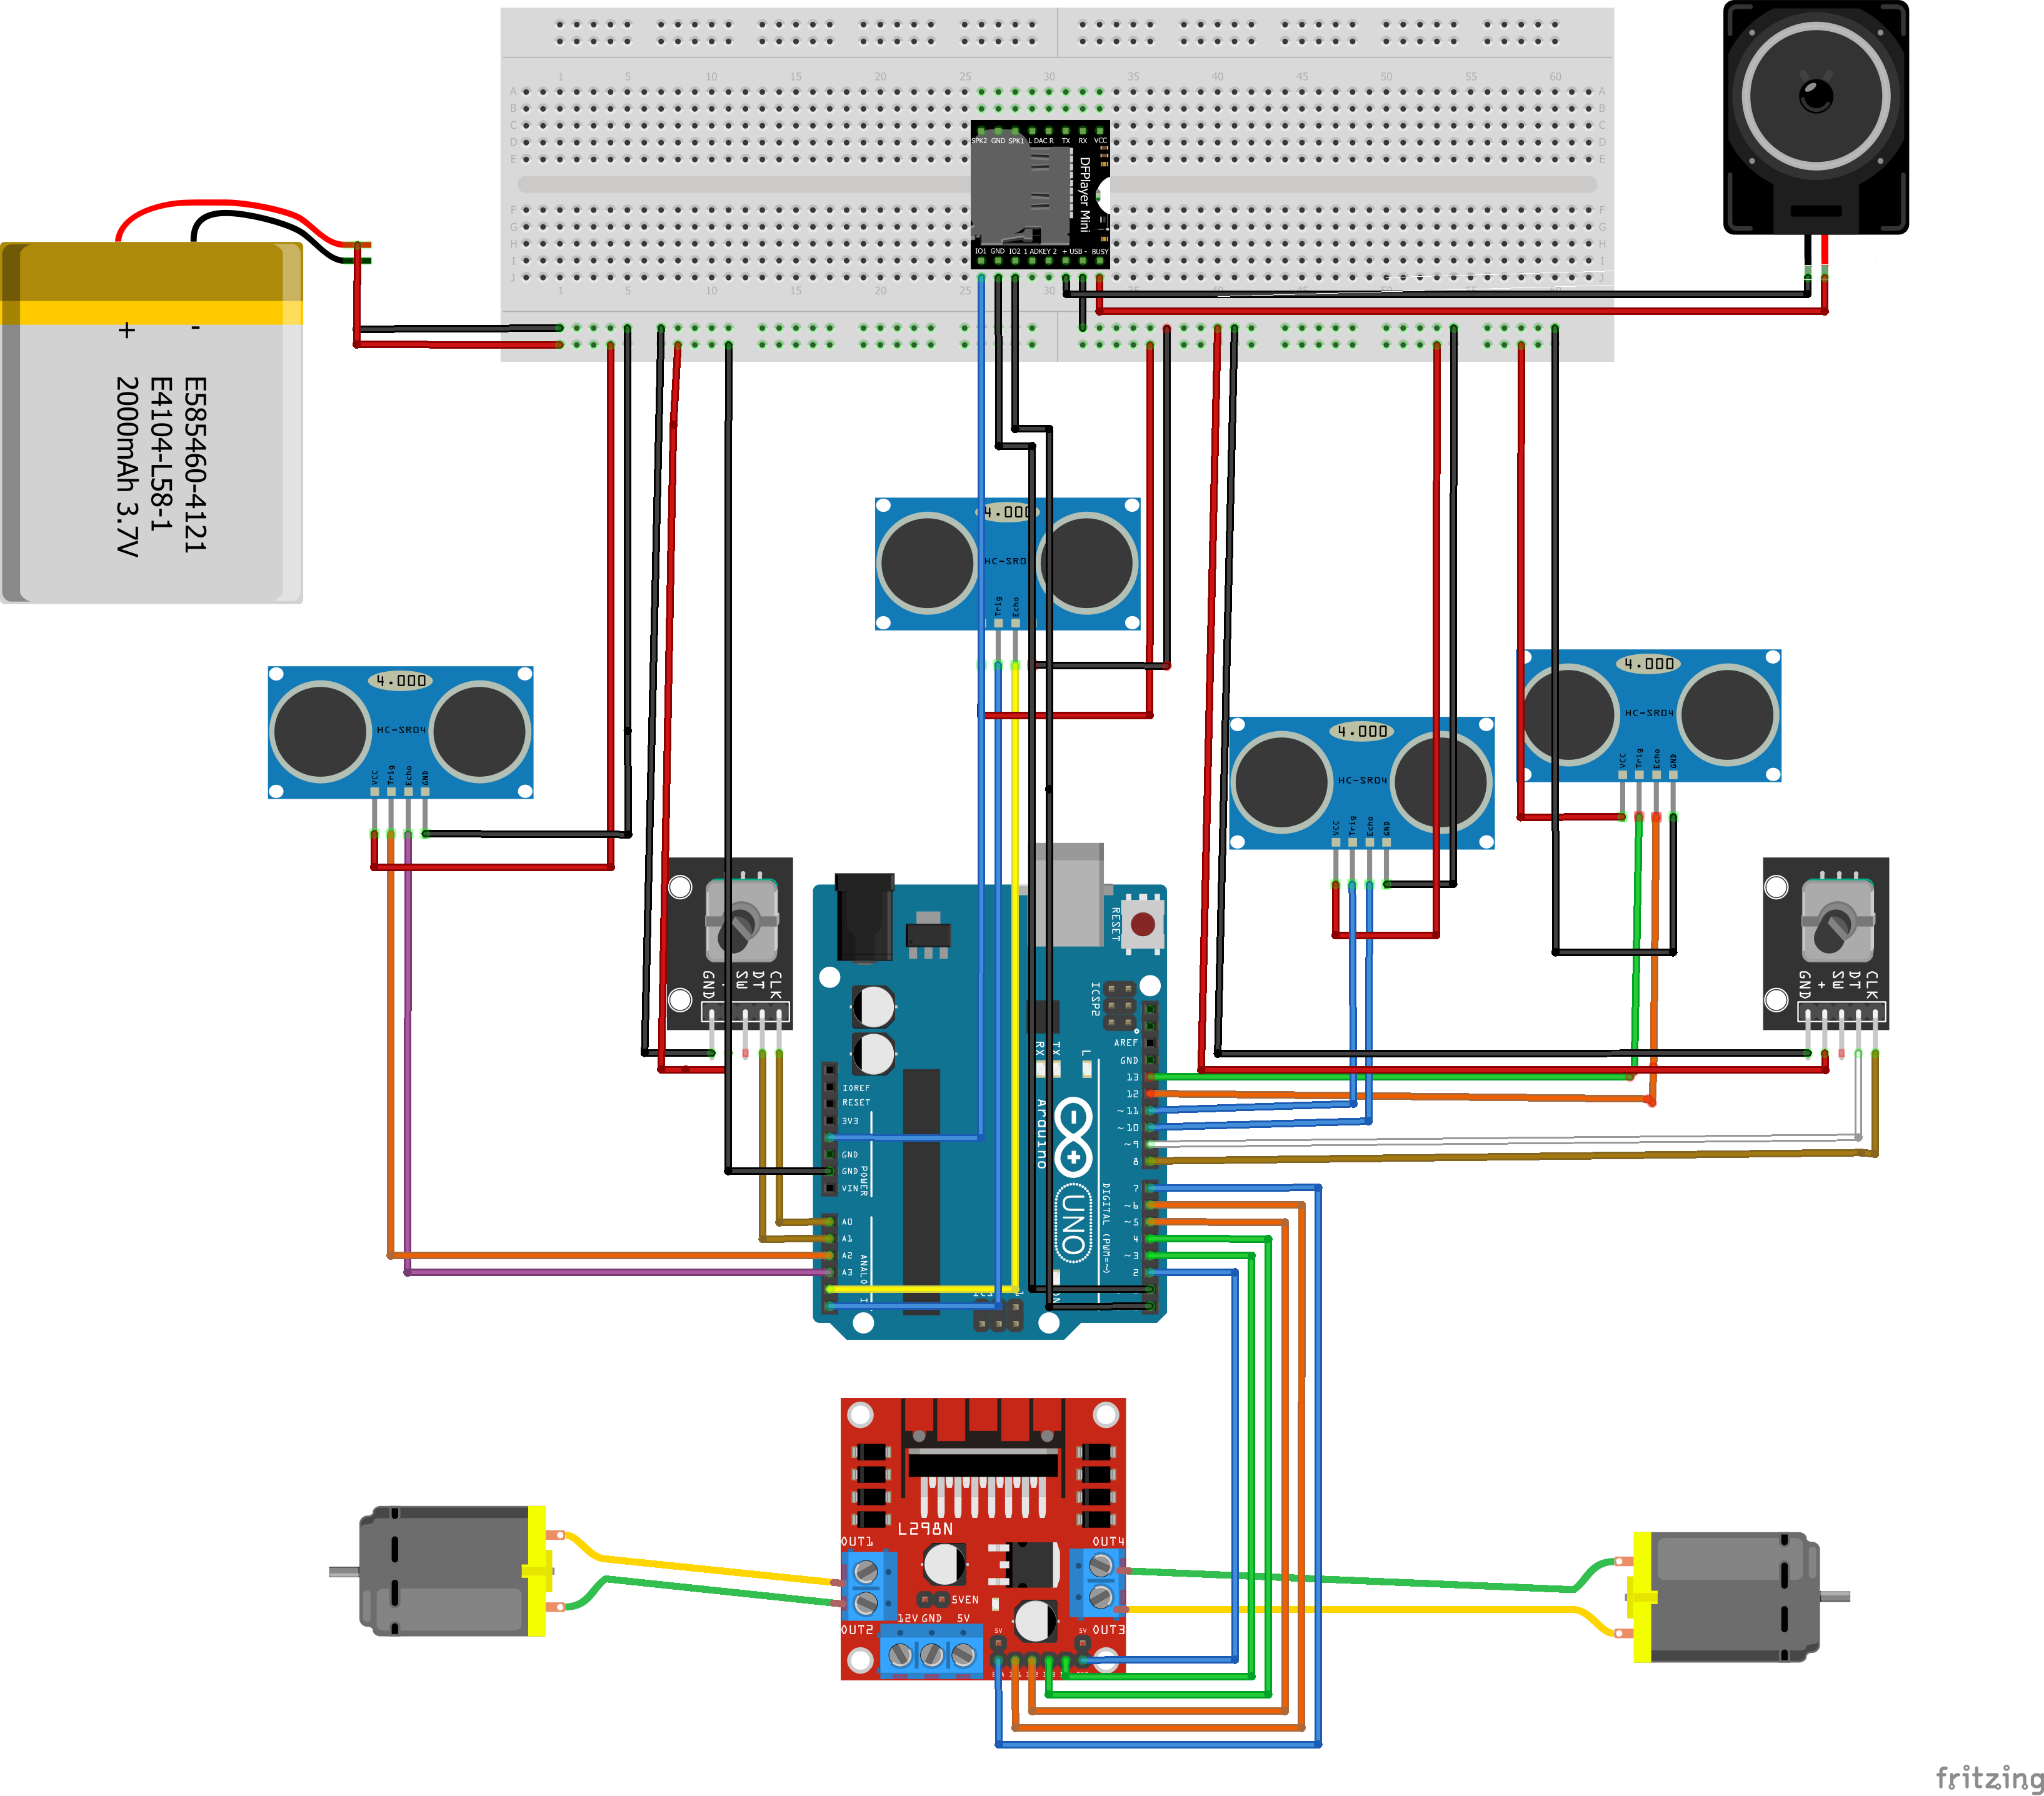
ECE-321
ECE-319

Slide 5
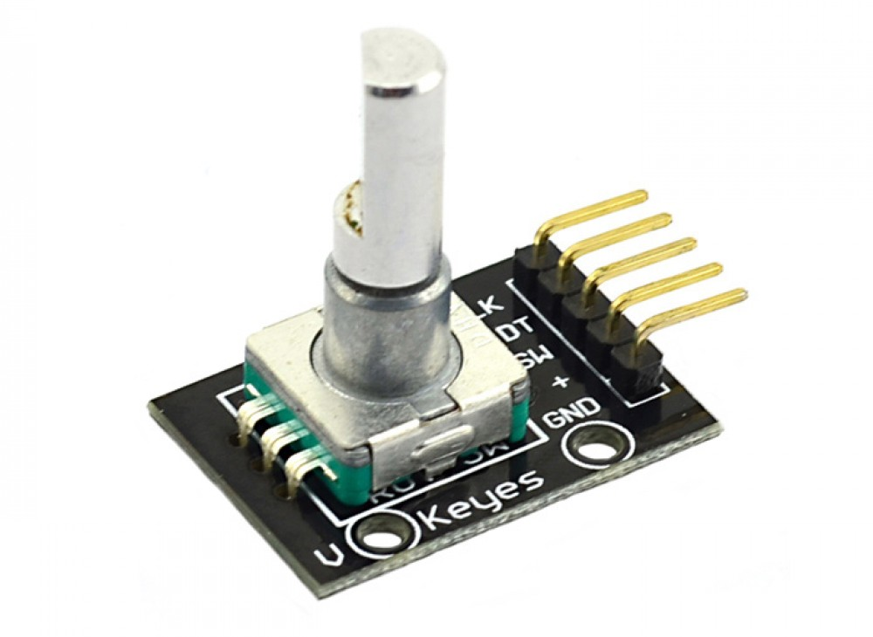
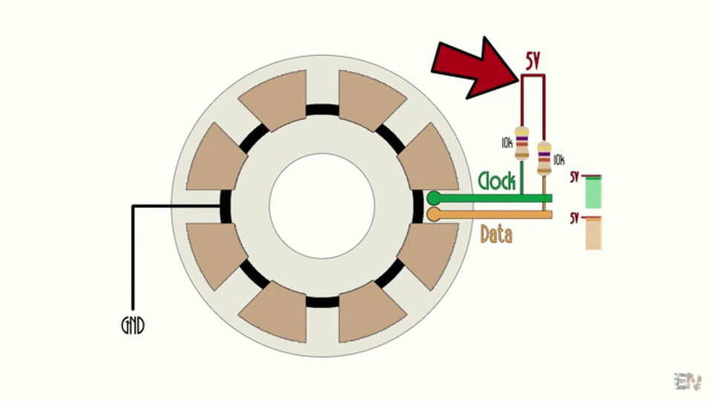
Methodology
What are the rotary encoders used for ?
Rotary encoders generates electrical pulses as the shaft turns. These pulses are interpreted by a controller to determine direction and distance of rotation.
They are used to take the reading from the wheel. When it rotates 10 times it means it has navigated a full cell which helps in creating the room map.
Figure 3: Incremental rotary encoder
Figure 4: Rotary encoder working principle
ECE-321
ECE-319
ECE-319

Slide 6
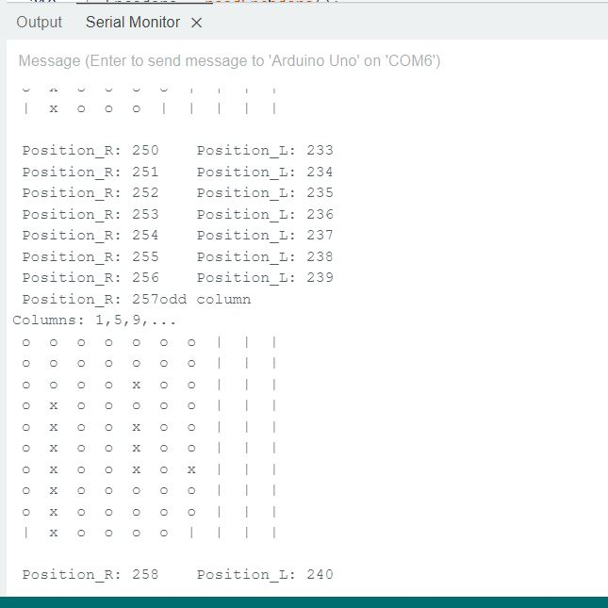
Methodology
0 1 2 3 4 5 6 7 8 9
How does the robot scan a room?
It moves in odd columns while detecting the current cell as well as the left, right, and front cells via the four ultrasonic sensors.
The robot iterates on most cells twice to achieve a minimal error percentage.
Figure 5: Actual example of a map
| Not yet detected
O Free
X Obstacle
ECE-321
ECE-319
ECE-319

Slide 7
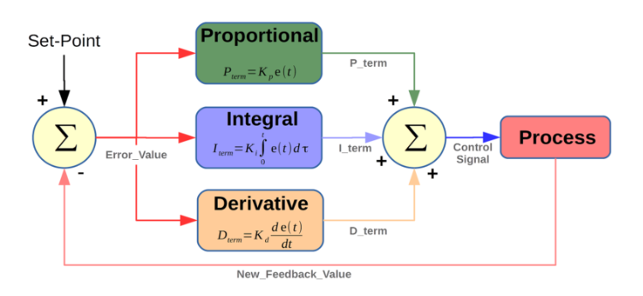
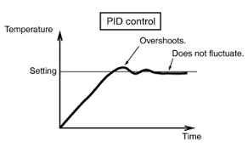
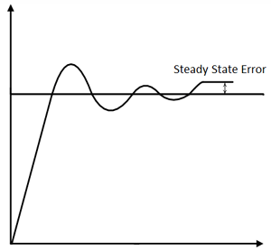
Methodology
Using PID Controller to make up for motor synchronization deficiency
Proportional (P): Adjusts output proportionally to current error.
Integral (I): Accumulates past errors to eliminate steady-state error.
Derivative (D): Predicts future errors by considering error rate of change to control system overshoot.
Figure 6: Rotary encoder
Figure 7: graphical representation of overshoots
ECE-321
Figure 8: Non-zero steady state error
ECE-319
ECE-319

Slide 8
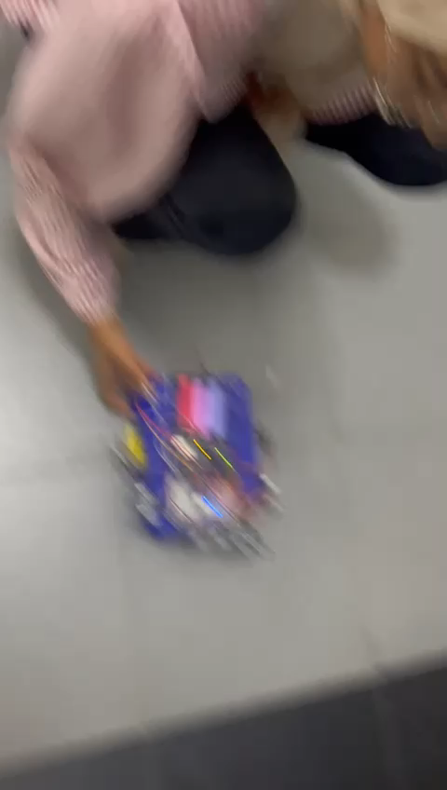
Real-life
Demo
Figure 4: Rotry encoder
ECE-321
ECE-319
ECE-319

Slide 9
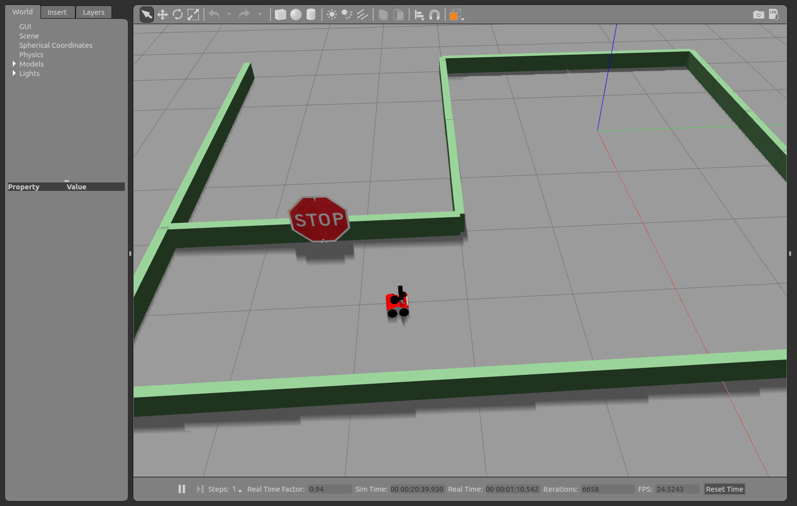
Future Plans
Fine-tune the controller parameters.
Use Robot operating System(ROS) for better control over multiple units.
Implement Dijkstra’s Algorithm to find the shortest route to a certain destination.
Apply Kalman filter on rotary encoder readings.
Figure 9: Robot Operating System
ECE-321
ECE-319
ECE-319

Slide 10
References
1 | Banzi, M. (2011). Getting Started with Arduino. Maker Media, Inc.
2 | Monk, S. (2012). Programming Arduino: Getting Started with Sketches. McGraw-Hill Education
3 | Margolis, M. (2014). Arduino Cookbook. O'Reilly Media.
4 | McRoberts, M. (2011). Beginning Arduino. Apress.
5 | Lang, M. (2013). Arduino Project Handbook: 25 Practical Projects to Get You Started. No Starch Press.
6 | Upton, E., & Halfacree, G. (2016). Raspberry Pi user guide. John Wiley & Sons.

Slide 11
Questions?

